Slide 1
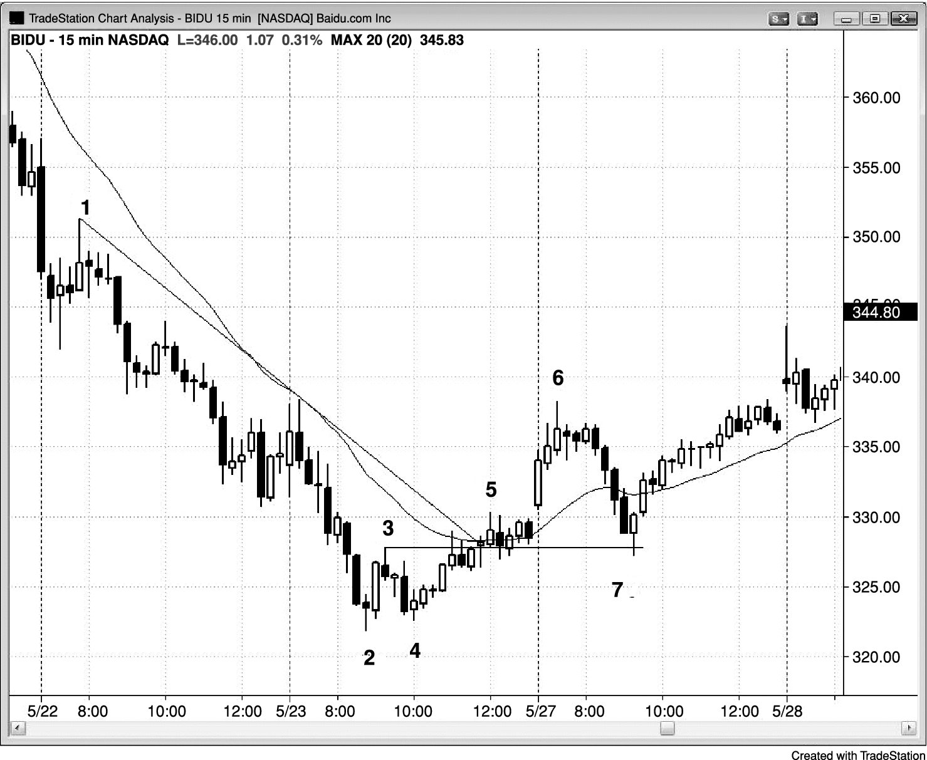
FIGURE 24.1 Swing Long after a Pullback from a Strong Rally

Slide 2
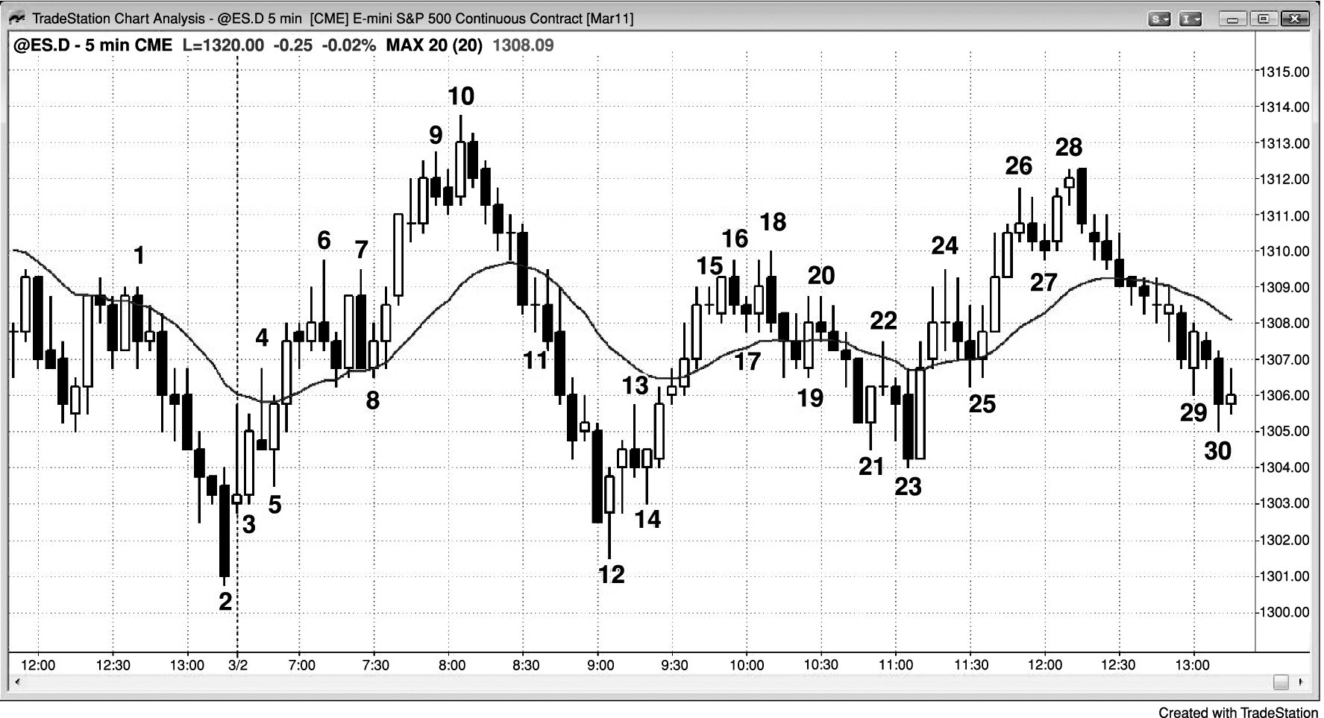
FIGURE 24.2 Swings Up and Down

